Slide 1

AI-Powered Target Recognition System
CAPESTONE PROJECT
Presented By
Student Name: SUJAN S
College Name: SRM INSTITUTE OF SCIENCE AND TECHNOLOGY, RAMAPURAM
Department: B. Tech CSE
Email ID: sujan5149481@gmail.com
AICTE Student ID: STU68104dfc9edd21745899004

Slide 2
OUTLINE
Problem Statement
Proposed System/Solution
System Development Approach
Algorithm & Deployment
Result (Output Image)
Conclusion
Future Scope
References

Slide 3
Problem Statement
General-purpose YOLO models lack the precision needed to identify weapons like guns or knives. False positives and missed detections pose serious security risks. Moreover, existing models demand powerful hardware, limiting real-world deployment in cost-sensitive or mobile environments.

Slide 4
Proposed Solution
The proposed system is an AI-Powered Real-Time Threat Detection Framework that leverages deep learning and thermal imaging to enhance public and institutional safety.
This system is designed to:
Detect weapons such as knives, guns, and potential explosive devices with high precision.
Utilize a custom-trained YOLOv11l.pt model on a weapon-specific dataset to overcome the limitations of general-purpose detection systems.
Support dual-mode surveillance using both RGB (normal camera) and thermal imaging for enhanced detection in low-visibility environments.
Implement a motion detection trigger mechanism to reduce unnecessary computation and improve responsiveness.
Deliver real-time alerts with visual annotation, buzzer activation, and automatic screenshot capture.
Be deployed on low-cost hardware platforms like Raspberry Pi and Jetson Nano without compromising performance.
This intelligent surveillance system not only minimizes human intervention but also ensures 24/7 vigilance, scalable deployment, and a proactive approach to security challenges in sensitive areas such as airports, schools, borders, and metro stations.

Slide 5
System Approach
Languages: Python 3.10.15
Frameworks/Libraries: OpenCV, PyTorch, Ultralytics YOLO, Pillow (PIL), Tkinter
Hardware: PC with GPU / Raspberry Pi / Jetson Nano
Tools: VS Code
Model Used: YOLOv11l.pt
Additional: SQLite DB for logging, Thermal Camera for bomb detection

Slide 6
Algorithm & Deployment
Algorithm Steps:
Capture video stream
Apply motion detection
Use YOLO to detect objects
Annotate and alert if weapon/bomb is found
Log data and store screenshots
Deployment:
Tested on GPU PCs (20–30 FPS)
Works with both RGB and thermal input
Deployable in schools, airports, or drones

Slide 7
Result
The system successfully detects weapons in both normal and thermal video feeds using a custom-trained YOLO model.
Image 1 (Normal Vision): The model detects a knife in the subject’s hand with a confidence of 0.61, alongside the person with 0.73 confidence. It immediately triggers a red alert message: “WARNING: Weapon Detected!”
Image 2 (Thermal Vision): The system identifies a potential Gun-like heat signature concealed under the clothing using thermal imaging. This detection is highlighted with a red bounding box, demonstrating the effectiveness of heat-based threat recognition even in low-light or obscured environments.
The results validate:
Real-time frame-by-frame processing
Dual-mode detection (RGB + thermal)
Triggered alerts, screenshots, and logging features
Achieved 20–30 FPS on GPU PC

Slide 8
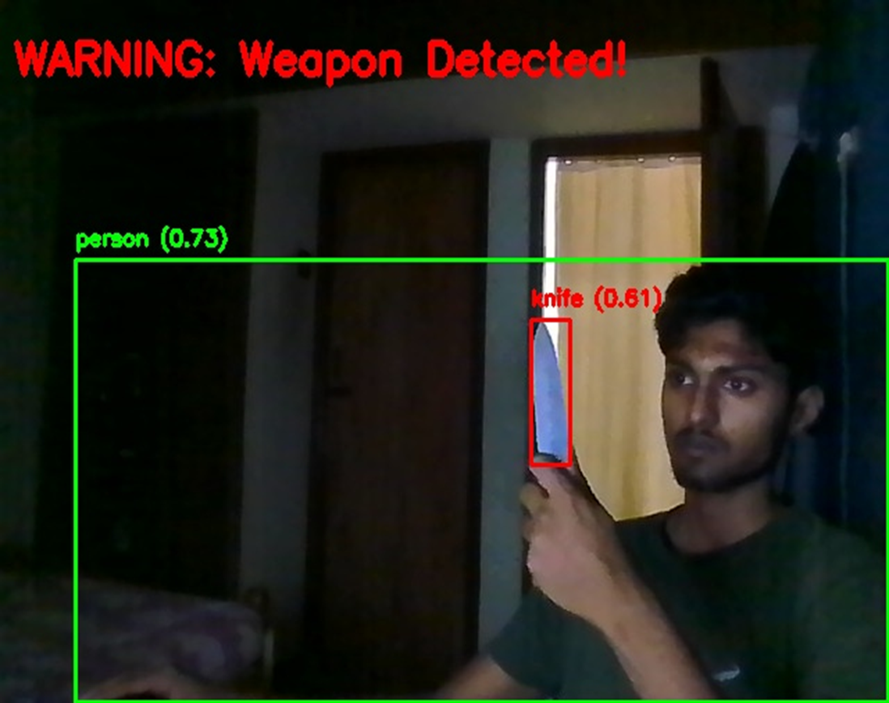
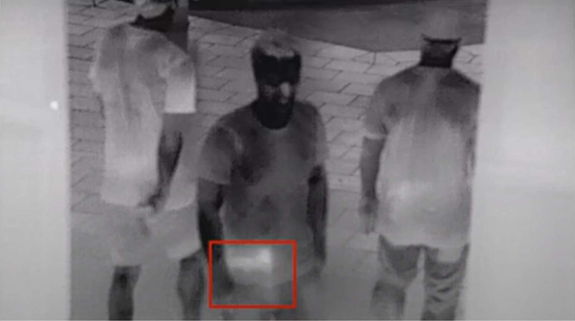
Result
Image 1 (Normal Vision)
Image 2 (Thermal Vision)

Slide 9
Conclusion
This project provides an efficient AI-based surveillance solution capable of real-time weapon detection using custom-trained YOLO models. By integrating thermal imaging, motion detection, and low-cost deployment hardware, the system ensures rapid, accurate threat detection with minimal human intervention.

Slide 10
Future scope
Drone-Based Surveillance Deploy the system on drones for outdoor areas like borders and public events with GPS tracking.
Sensor Fusion Integrate with LIDAR, RADAR, and infrared for improved detection in low-visibility or smoke-filled environments.
Automation & Access Control Auto-lockdoors or alert security teams instantly upon weapon detection.
Model Enhancement Train with a larger, more diverse dataset to improve accuracy and reduce false positives.
Alert System Integration Enable real-time alerts via SMS, email, or mobile apps with captured frame & location.
Edge & Cloud Deployment Use lightweight edge devices for offline use and cloud sync for centralized analytics.
Extended Use-Cases Re-train model for fire detection, intruder alerts, and missing person identification.

Slide 11
References
Weapon Detection Using YOLO V3 – Wiley
Real-Time Weapon Detection Using YOLOv8 – arXiv
Real-Time Deep Learning Weapon Detection Techniques – arXiv
GitHub Link: Link

Slide 12
Thank you

